Slide 1
IP Networking Basics
Open Sourcery

Slide 2

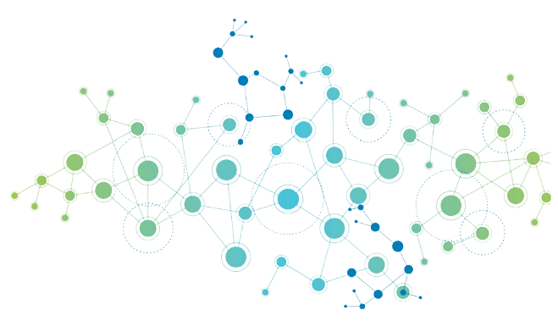


What’s an internet?
An internet:
The Internet™:
“Can talk with one another…”
Notes:
An internet is a collection of computers that can talk to one another. This is called a network, mainly to avoid confusion with the big internet. The Internet with a capital I is the worldwide network that we use every day.
But I mentioned that the computers can talk with one another…

Slide 3



How can machines talk with one another?
Using agreed upon rules
A rule set called network protocol
Notes:
How do they do that?
They do that using agreed upon rules. An analogy to these rules would be how, if you wanted to send a letter but left the address blank and without a stamp, the letter wouldn’t be sent.
We call a rule set that a network uses it’s network protocol.

Slide 4
What is IP?
Internet Protocol (IPv4 and IPv6) — most widely used network protocol
Governs:
Addressing
Routing
Structure of information
Notes:
Now IP is just the “Internet Protocol” — the most widely used network protocol. You can find others being used in smaller use cases, and typically in legacy system.
This protocol governs addressing (how computers identify themselves to the world), routing (how information gets passed along until it hits the proper address), and structure of information.

Slide 5

Packets
Information that is structured according to network rules
Just 1’s and 0’s, living their best life
Notes:
Now, all packets are is information that’s structured according to network rules. It’s 1’s and 0’s living their best life.

Slide 6
IP Header
Header
Options
20 bytes at the beginning of the message
Meta information
Data
Packet
Notes:
Now, IP protocol requires every packet sent to contain the IP header: 20bytes of information at the beginning of the message. It contains meta information necessary for the packet to get where it needs to go.

Slide 7




Big Idea: Encapsulation
Header
Options
Data doesn’t affect routing of info!
Can send anything over an IP network
Doesn’t matter!
Data
Packet
Notes:
The big idea behind this structure is encapsulation: what the data is doesn’t matter to getting the data where it needs to go.

Slide 8
DEMO TIME
If on windows, on your favorite terminal, run:
tracert google.com
If on mac or linux, on your favorite terminal, run:
traceroute google.com
Let’s trace a packet along the network!
Notes:
So, let’s see a packet traveling along the network! Take out your laptops and let’s see this happen.
If you’re on a windows machine, and if you can log onto grace, log onto grace now. This lets you run linux commands, which are a bit easier. If you don’t know what this means, don’t worry about it.
Run this command:
Traceroute google.com —> linux or ma
Tracert google.com —> windows. A lot slower for some reason
And tada, here your see your packet traversing the Internet, big I, in order to get to google.
So what traceroute does is a little complicated, but the big idea is that it sends a packet meant to diagnose things in the network and asks all machines that see it to respond.
Several things to note here:
Information gets across the internet in a similar way to how a package gets shipped on Amazon: with many stops along the way in places like Iowa.
Hops are what we call individual steps in going over the network, say from a warehouse in Iowa to a warehouse in Maryland. A packet is typically constrained to 30 hops, which is meant to ensure no packet circles the internet forever and gets dropped instead.
And fun fact: this counter is in an IP header!
Now if we do another website, say bing, you might get these stars. What this means is that it hit a routine machine that isn’t configured to respond to the packet that we’re sending out. Traceroute sends out an ICMP packet, which is meant for diagnostics.
https://www.redhat.com/sysadmin/traceroute-finding-meaning#:~:text=If%20the%20traceroute%20command%20completes,an%20issue%20on%20the%20network. If I need to remember shit about traceroute
https://www.cs.ait.ac.th/~on/O/oreilly/tcpip/firewall/ch06_03.htm about packets and stuff

Slide 9
Packet Types
Header
Options
Data can have structure too!
Often has its own meta info
IP Header has info about what type of packet is being sent
Data
Header
Packet
Data
Notes:
Now, one thing that demo hinted as is that there are different types of packets — we sent one used for diagnostics.
Packets are differentiated by the structure of their data. There are different types of packets — TCP and UDP are very common ones
What type of packet is being sent is included in the big IP header
To reiterate though, all these packet types are conventions and rules that humans made so machines can actually talk to one another

Slide 10
Ports
Notes:
This section is easily the worst

Slide 11


Motivation
Notes:
So machines are receiving these packets constantly. They’re also constantly sending packets out
But how does a machine keep track of where packets should go? How does it ensure that when your discord app sends a request, that the data you get back goes pack to the discord app?

Slide 12
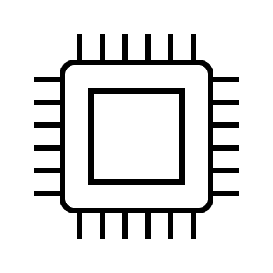
Ports
80
“Virtual places” in OS where packets are sent from and to
Each port is connected to an application
64
20
2165
200
53490
333
Notes:
So now, we gotta talk about ports.
Ports are, in a way, virtual places in the operating system where packets are sent from and to
In reality, it’s a way that the operating system sorts different types of packets
For example, different apps will “open up” ports in order to be able to send and receive messages

Slide 13
Note: ports are NOT part of the IP header
Certain types of packets require ports
Because ports organize data within a machine: don’t matter outside of a machine.

Slide 14
Types of Ports
Permanent — connected to permanent applications
Often used to send data upon request
Permanent ports have numbers with agreed upon meanings
E.g. port 80, by convention, has HTML data
Ephemeral — for temporary requests
Often used for requesting and receiving data from a permanent port
Have high numbers, and are random

Slide 15
DEMO TIME
Sending packets using Python!
Goal: ~experience~ ephemeral ports
Notes:
First note: I’m currently using two VMS that I got as a part of one of my classes, so sadly this isn’t directly recreatable.
On one side, we have a container that’s going to receive UDP packets, a pretty simple type of packet that requires a port
So here’s the code for receiving code. We have the IP address of where this is running

Slide 16
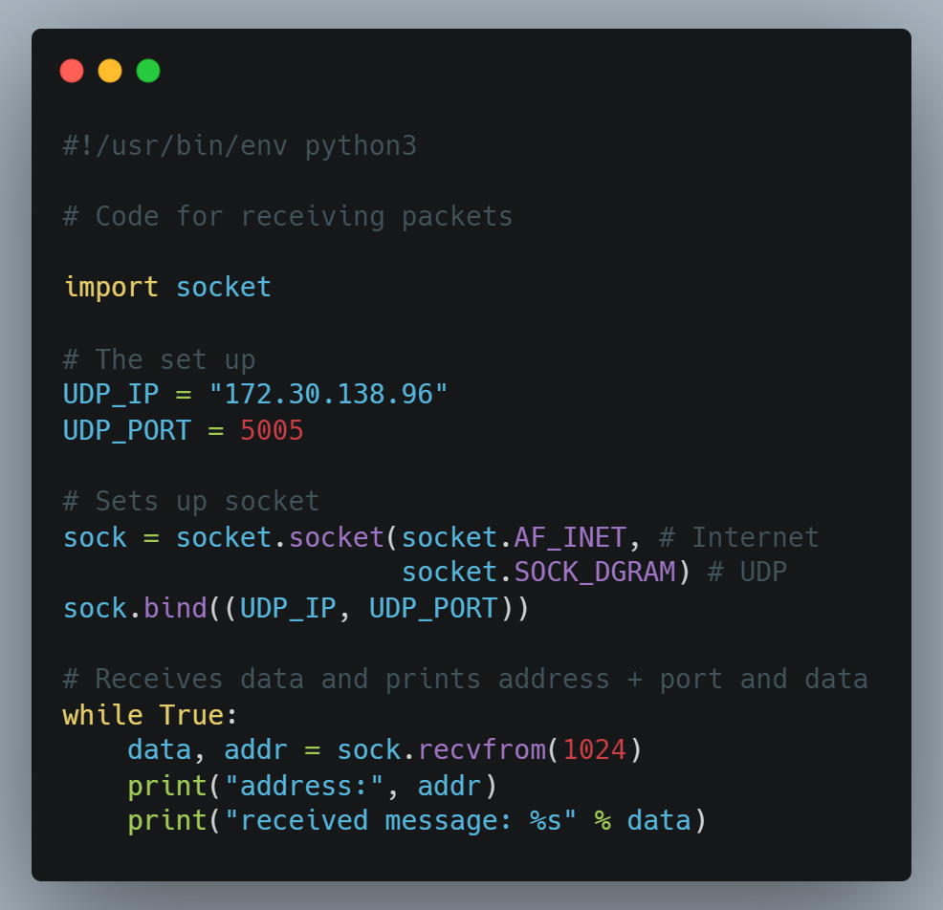
Receiving
Opens port 5005 on local machine
Notes:
First note: I’m currently using two VMS that I got as a part of one of my classes, so sadly this isn’t directly recreatable.
On one side, we have a container that’s going to receive UDP packets, a pretty simple type of packet that requires a port
So here’s the code for receiving code. We have the IP address of where this is running

Slide 17
Receiving
When it receives data, prints the IP + port it got it from, and the data
Notes:
First note: I’m currently using two VMS that I got as a part of one of my classes, so sadly this isn’t directly recreatable.
On one side, we have a container that’s going to receive UDP packets, a pretty simple type of packet that requires a port
So here’s the code for receiving code. We have the IP address of where this is running

Slide 18
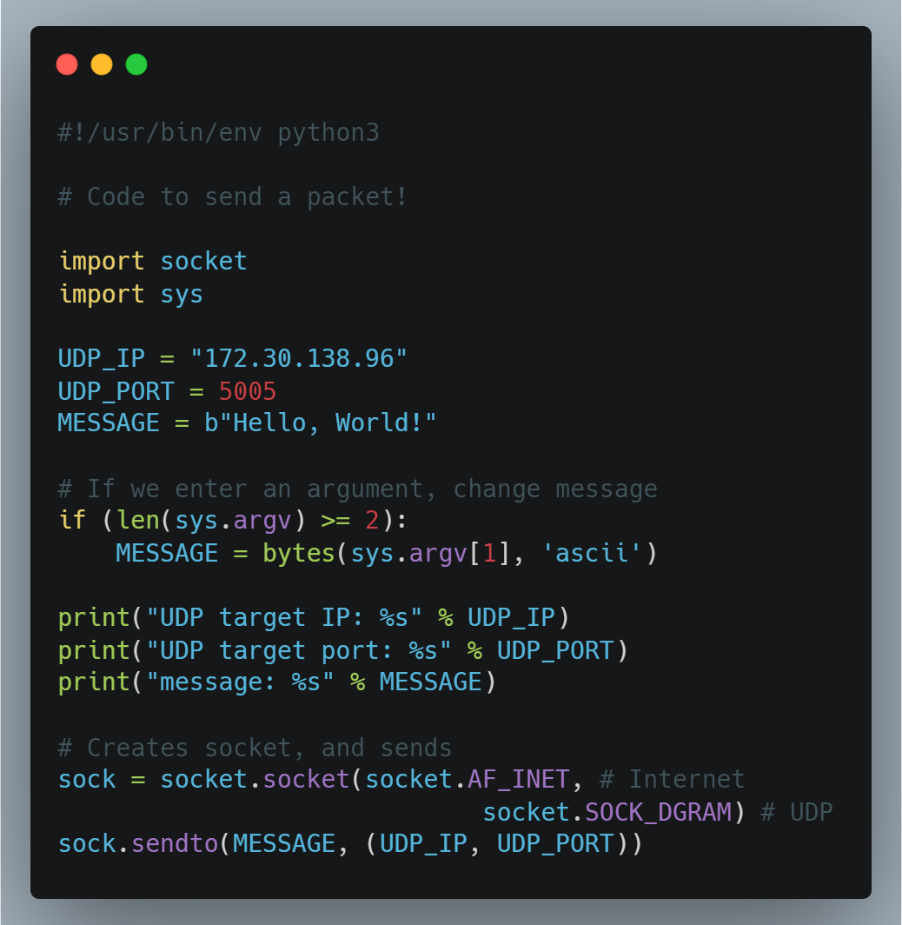
Sending
Targets opened port
Notes:
First note: I’m currently using two VMS that I got as a part of one of my classes, so sadly this isn’t directly recreatable.
On one side, we have a container that’s going to receive UDP packets, a pretty simple type of packet that requires a port
So here’s the code for receiving code. We have the IP address of where this is running

Slide 19
Sending
Custom messages
Notes:
First note: I’m currently using two VMS that I got as a part of one of my classes, so sadly this isn’t directly recreatable.
On one side, we have a container that’s going to receive UDP packets, a pretty simple type of packet that requires a port
So here’s the code for receiving code. We have the IP address of where this is running

Slide 20
Sending
Sends the message to the IP and port
Notes:
First note: I’m currently using two VMS that I got as a part of one of my classes, so sadly this isn’t directly recreatable.
On one side, we have a container that’s going to receive UDP packets, a pretty simple type of packet that requires a port
So here’s the code for receiving code. We have the IP address of where this is running

Slide 21
Let’s see what port they come from!
Notes:
First note: I’m currently using two VMS that I got as a part of one of my classes, so sadly this isn’t directly recreatable.
On one side, we have a container that’s going to receive UDP packets, a pretty simple type of packet that requires a port
So here’s the code for receiving code. We have the IP address of where this is running

Slide 22
IP Exhaustion and NAT

Slide 23
IP(v4) Addresses
142.250.188.206
4 bytes — 32 bits

Slide 24
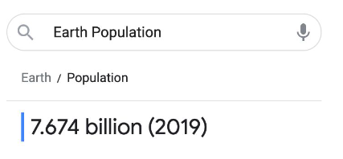

How many IP Addresses are there?
2³² = ~4.2 billion
But… um…

Slide 25
IPv6 Addresses
4514:5776:90e3:d6bb:8565:bf9e:3f0e:2970
16 bytes — 128 bits
340 trillion trillion addresses!

Slide 26
Are we using IPv6?
We’re transitioning
But we’re able to connect all those devices under IPv4
How?

Slide 27
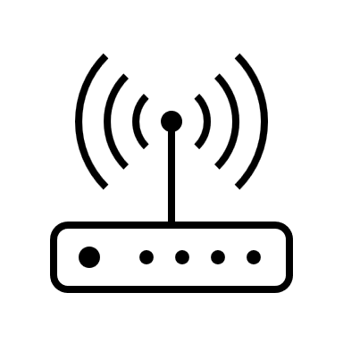
Your Router!

Slide 28

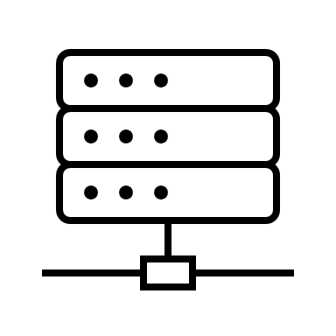
What your router does
Self contained
Notes:
Routers make all traffic go through one gateway to the big internet, and vice versa
Routers create networks that are completely separate from the big internet
They make all traffic from your machine to the Internet go through translation at the router
So, none of the machines in your little network have a public IP address

Slide 29
Public and Private Addresses
Private Addresses
- Only visible inside
192.168.1.5
192.168.1.1
128.8.27.57
192.168.1.9
Public Address
- Visible on Internet™
192.168.1.42
Notes:
The router has a public IP address that the Internet, big I, can see
Then, the router initializes a small, self contained network with private IP addresses
Some Ips are reserved for private addresses. 192.168.x, 172.x, and 10.x are the most common ones
This is why your IP almost always something like that

Slide 30

Sending a packet
To: google
From: Lana

Slide 31
Sending a packet
To: google
From: Lana

Slide 32
Sending a packet
To: google
From: Lana

Slide 33

Sending a packet
To: google
From: Router

Slide 34
Sending a packet
To: google
From: Router
Google does NOT know that I sent this

Slide 35
Sending a packet
To: Router
From: google

Slide 36
Sending a packet
To: Router
From: google

Slide 37
Sending a packet
To: Lana
From: google

Slide 38
Sending a packet
To: Lana
From: google

Slide 39
Public and Private Addresses
192.168.1.5
128.8.27.57
Notes:
In reality, the “from” is your computer’s private IP address, while what the router replaces it with is the public IP address
So the addresses are, in a way, translated from private to public

Slide 40
NAT — Network Address Translation
Notes:
This is called Network Address Translation, because the IP addresses

Slide 41
(QUICK) DEMO TIME
Seeing NAT happen
Notes:
Use hostname -I to see the IP of the aces vm
And show that’s the receiving thought it received the message from a different IP
This is because a router is in the middle translating things

Slide 42
Some Mechanics of NAT
Router has NAT table
Has different rules for translating different types of packets
Most often, creates an ephemeral port on the router to receive the responses

Slide 43
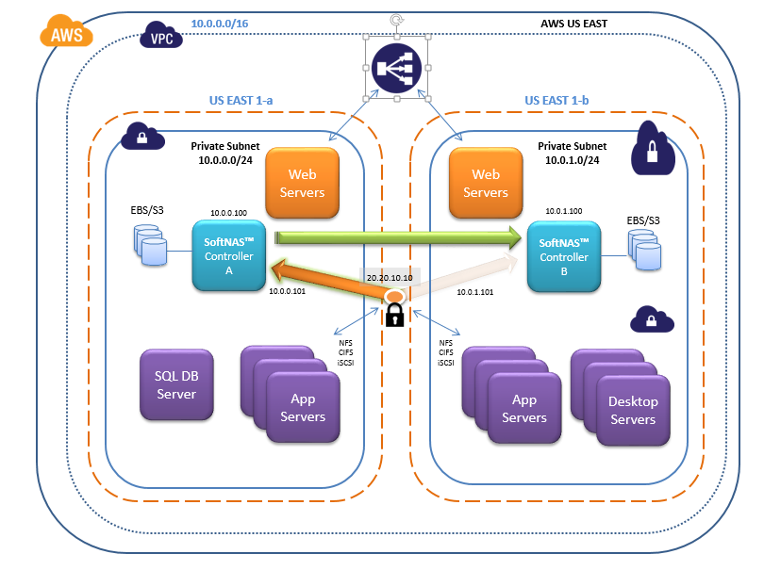
Fun facts
NAT doesn’t increase security — a common myth
But does make it easier to set up security, since all traffic goes through one bottleneck
So, in general, private networks more secure
Can have many layers of NAT
Router stores NAT table in RAM, and routers have ~128 MB of RAM
If RAM overflows, you have to restart your router!

Slide 44
Application: Virtual Private Network
Depending on time, we’ll skip this~

Slide 45


You’re a company, and you have sensitive info
Only a private network
Random cloud, like Google Drive
How do you get security of private network while allowing remoteness?

Slide 46
Virtual Private Network
Tunnel, publicly
Computer now looks like it’s on the private network

Slide 47


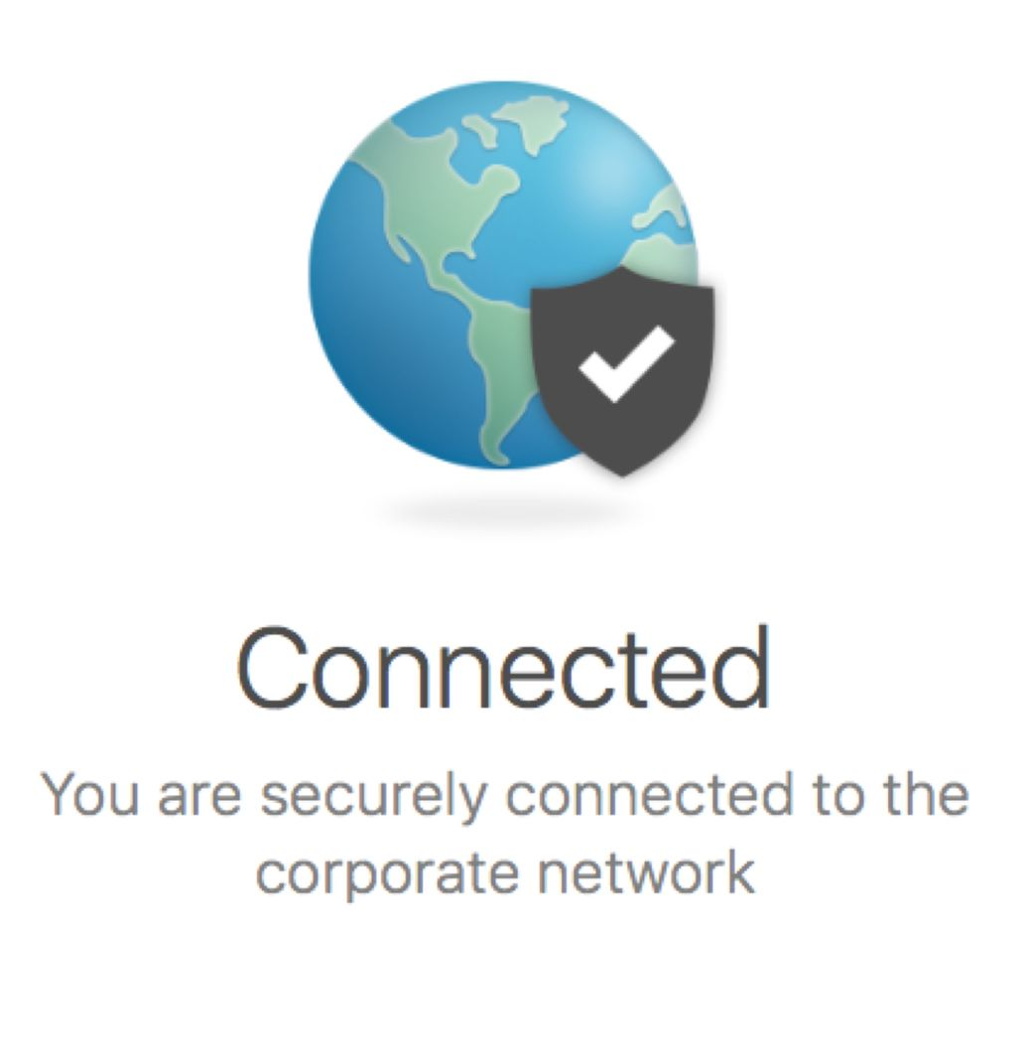

I wonder where you’ve seen this before…
I wonder…

Slide 48
Commercial VPNs
Allow you to tunnel to a remote router and make it look like you’re based there
The principle behind VPNs allowing you to access geographically locked data!

Slide 49
Cool: DNS
Depending on time, we’ll skip this~

Slide 50
Domain Names
Domain name like “google.com” is an alias for google’s IP
How do we go from typing in “google.com” to getting it’s IP address?

Slide 51
DNS — Domain Name System
Google.com?
DNS recursive resolver
- Assigned to you by router

Slide 52
DNS — Domain Name System
Google.com?
First, looks in cache
If not in cache…

Slide 53
DNS — Domain Name System
Google.com?
Asks the DNS root servers

Slide 54

DNS — Domain Name System
Google.com?

Slide 55
DNS — Domain Name System
142.250.188.206!

Slide 56
DEMO
DIG
Aka
Mac, linux: dig google.com
Windows: nslookup google.com

Slide 57

DNS — Domain Name System

Slide 58
Yeah!! Go UMD!!
Lots of research is done using traffic we get from DNS
Dr. Dave Levin is one of the professors who’s invested in it

Slide 59
A lot more to learn!
DNS specifics
Different types of packet/connection protocols
TCP and the TCP handshake
UDP
Network encryption — TLS handshake
How tunneling works
Firewalls in general
And more…

Slide 60

Thank you!

